Slide 1
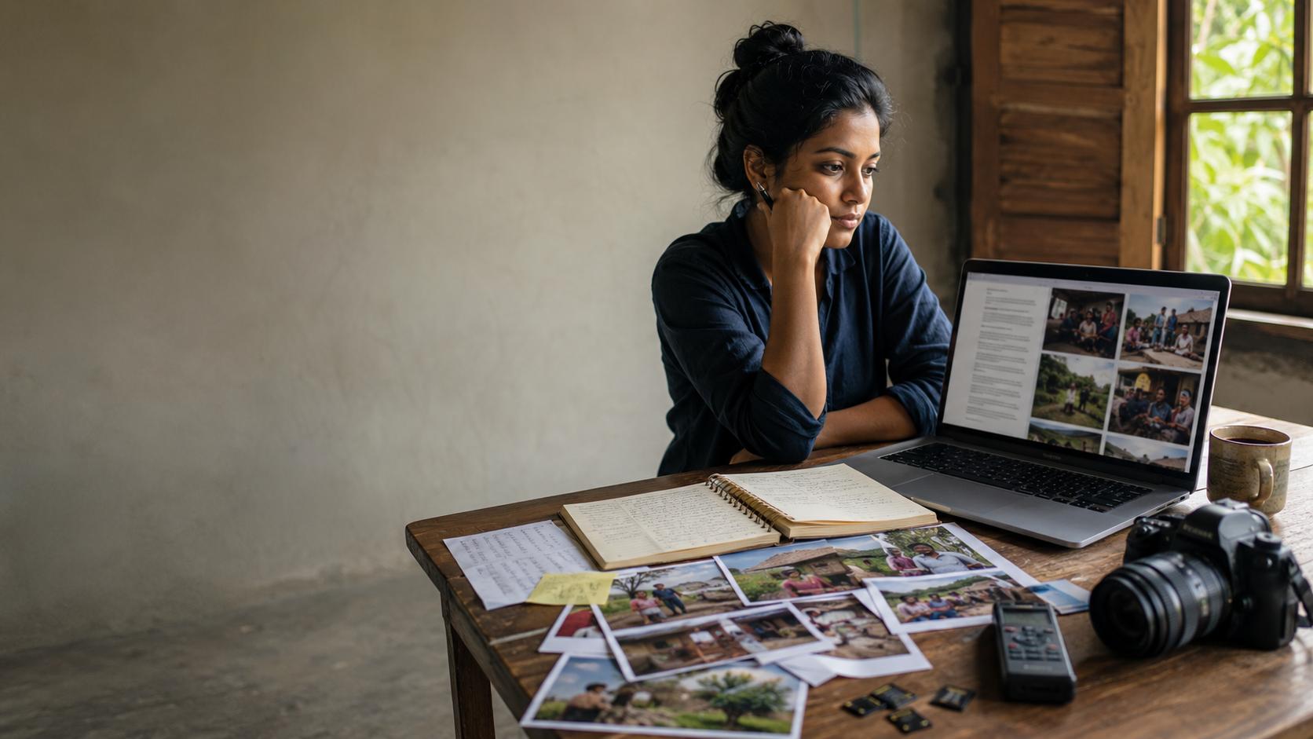

COMMUNICATION TRAINING
Telling the Story
Choosing the Right Format
for Field Stories
Jim Killam
Notes:
https://docs.google.com/document/d/1Ivh-TZGJCguyMqG25uSjx_QOaHlxZr6ciNvHSbi-PGo/edit?tab=t.0

Slide 2
COMMUNICATION TRAINING
Telling the Story
Planning, Gathering
& Organizing Information
that Best Serves Your Audience
Jim Killam

Slide 3




Things we need to be able to do well:
Plan a story-gathering trip or interview around a clear purpose and audience
Gather strong raw material — whether you're on location or working remotely
Organize scattered notes, quotes, and interviews into a clear story spine
Choose the format that best serves your audience, story, and resources
Notes:
Note the progression

Slide 4
The Challenge
How do I turn all of this raw material
into something that connects with
our audience?
Notes:
(British novelist and journalist)

Slide 5
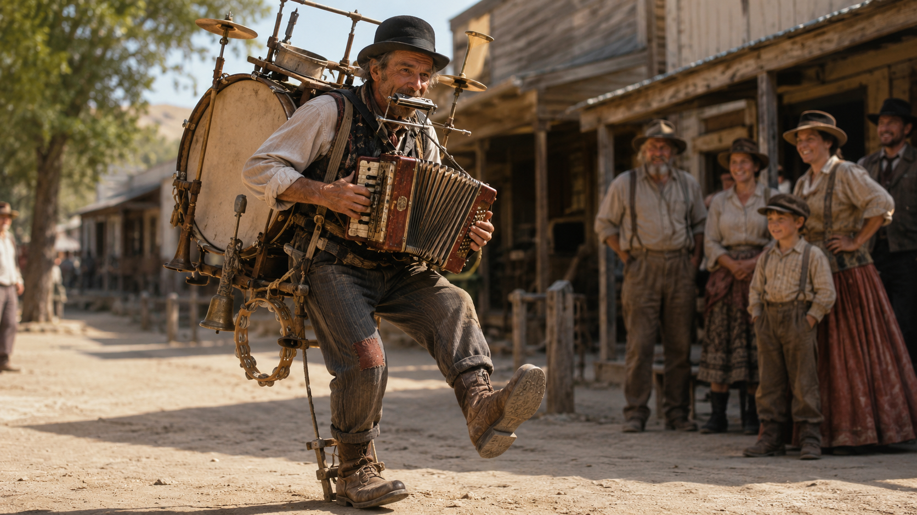
The One-Man Band
Notes:
(British novelist and journalist)

Slide 6




The Challenge: Choosing the Right Format
Too many choices, too little time
You've just returned from a project visit — or wrapped up a remote interview. You have notes, photos, maybe a recording. Now what?
?
A written story?
A video?
A photo essay?
A podcast?
All of the above?
Other?
Just because you collected lots of raw material doesn’t mean you need to use it all.
You have given yourself options.

Slide 7

One Framework, Four Steps
Use this when you plan a story — remote or on-site
→
→
→
PLAN
GATHER
ORGANIZE
CHOOSE
Purpose, audience, key message
Interviews, photos, sound, detail
Sort it into a story spine
Pick the format that fits
Feeling stuck on one step might mean you didn’t pay enough attention to the previous step.
Notes:
Being stuck on one step might mean you failed in a previous step (similar to writer’s block)

Slide 8
Step 1 — Plan Before You Go (or Call)
What is the purpose of this story? (recruit, inform, inspire giving, celebrate)
?
Who is the audience — donors, partners, church members, the global church?
?
What is the one short, key message this story needs to carry?
?
What format constraints do we already know? (deadline, access, budget, skills)
?

Slide 9
Step 2 — Gather Good, Usable Material
On-Site Visits
Remote Interviews
Capture wide shots, close-ups, and candid moments
Test the call and recording tech beforehand
Record ambient sound, not just talking-head audio
Ask the partner to send extra photos or short clips
Get names, titles, and spellings on the spot
Slow down — build in time for interpretation
Ask permission and explain how the story will be used
Record the call (with permission) instead of relying on notes

Slide 10
Step 3 — Organize: Find the Spine of the Story
Also called the kernel or the central arc.
1
2
3
4
5
Setting
→
Person
→
Challenge
→
Turning Point
→
Impact (Transformation) / Hope
Quick test: Can you tell this story in five sentences — one per box — using only material you actually gathered? If a box is empty, that's your next question to ask.

Slide 11



Step 4 — Choose the Format That Best Serves the Story
Audience
Material
Where will they encounter this — social feed, newsletter, church service, etc.?
What's strongest: a face and voice, a compelling fact, a quiet conversation?
Resources
Re-use
What skills, equipment and time do we realistically have before our deadline?
Can one trip supply more than one format, if we plan for it up front?
Notes:
Caution on re-use – doing more than one thing means something will be sacrificed

Slide 12
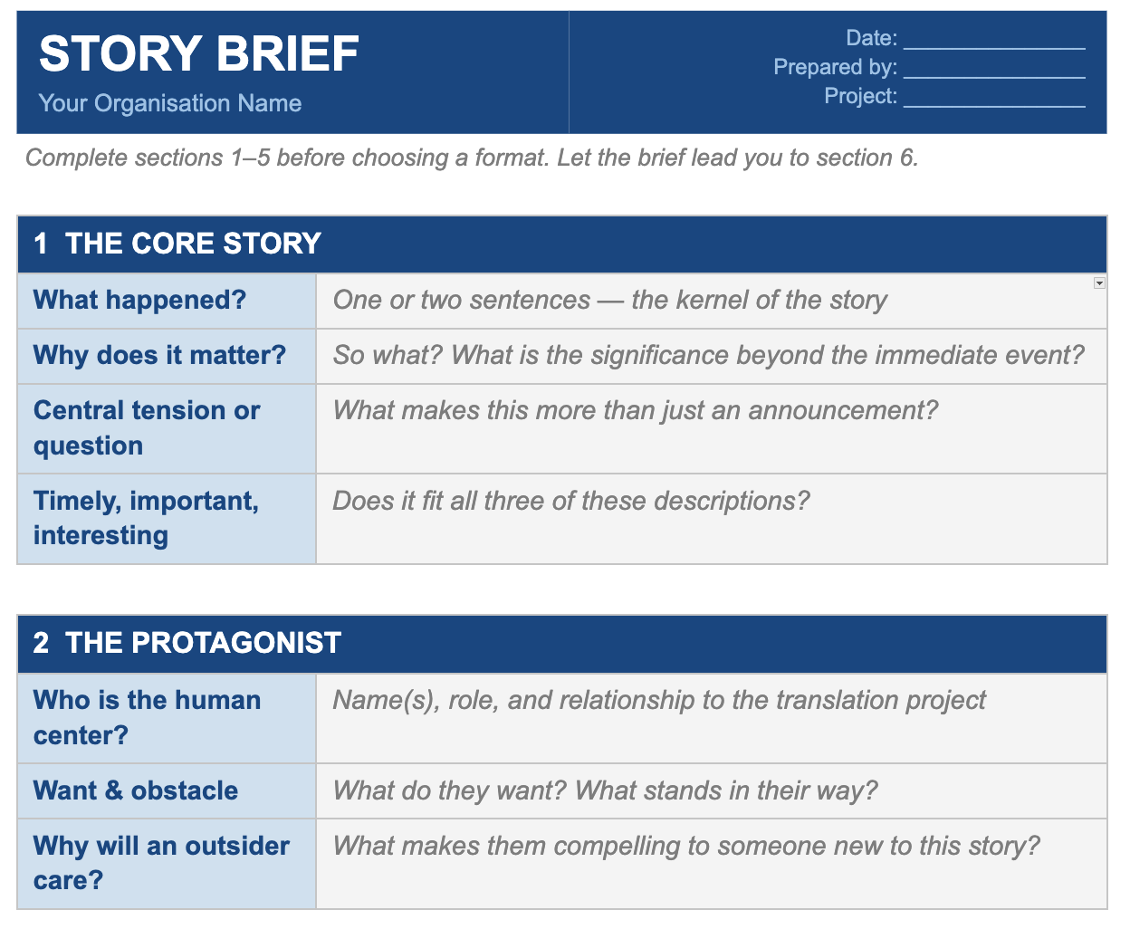
Notes:
https://docs.google.com/document/d/1Ivh-TZGJCguyMqG25uSjx_QOaHlxZr6ciNvHSbi-PGo/edit?tab=t.0

Slide 13
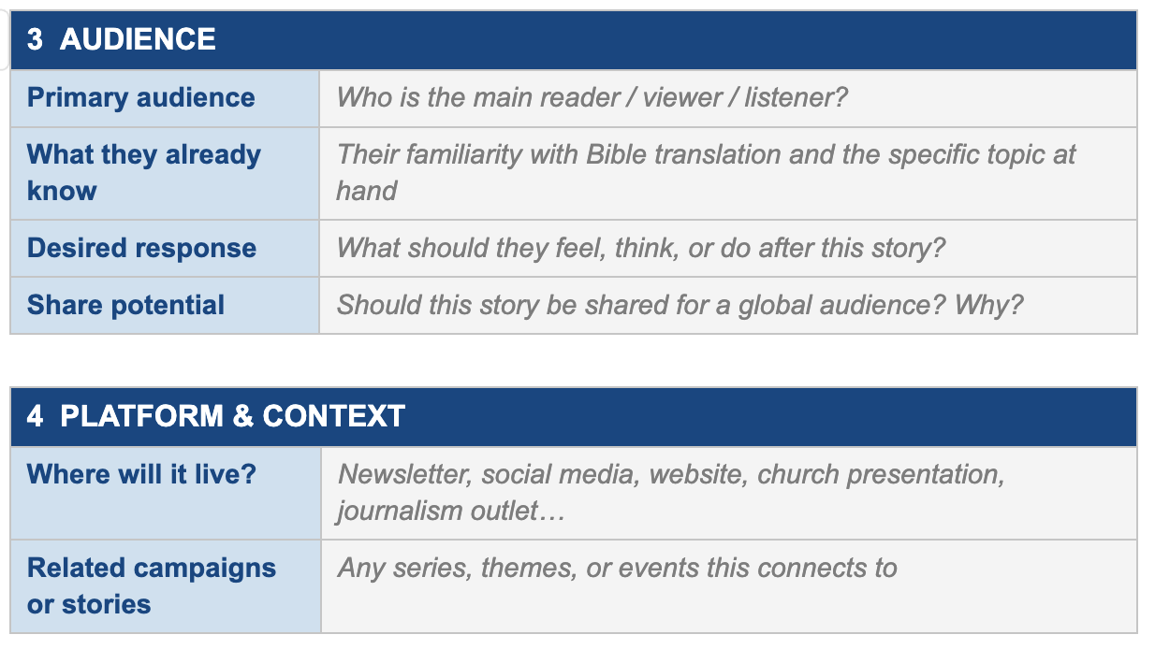

Slide 14
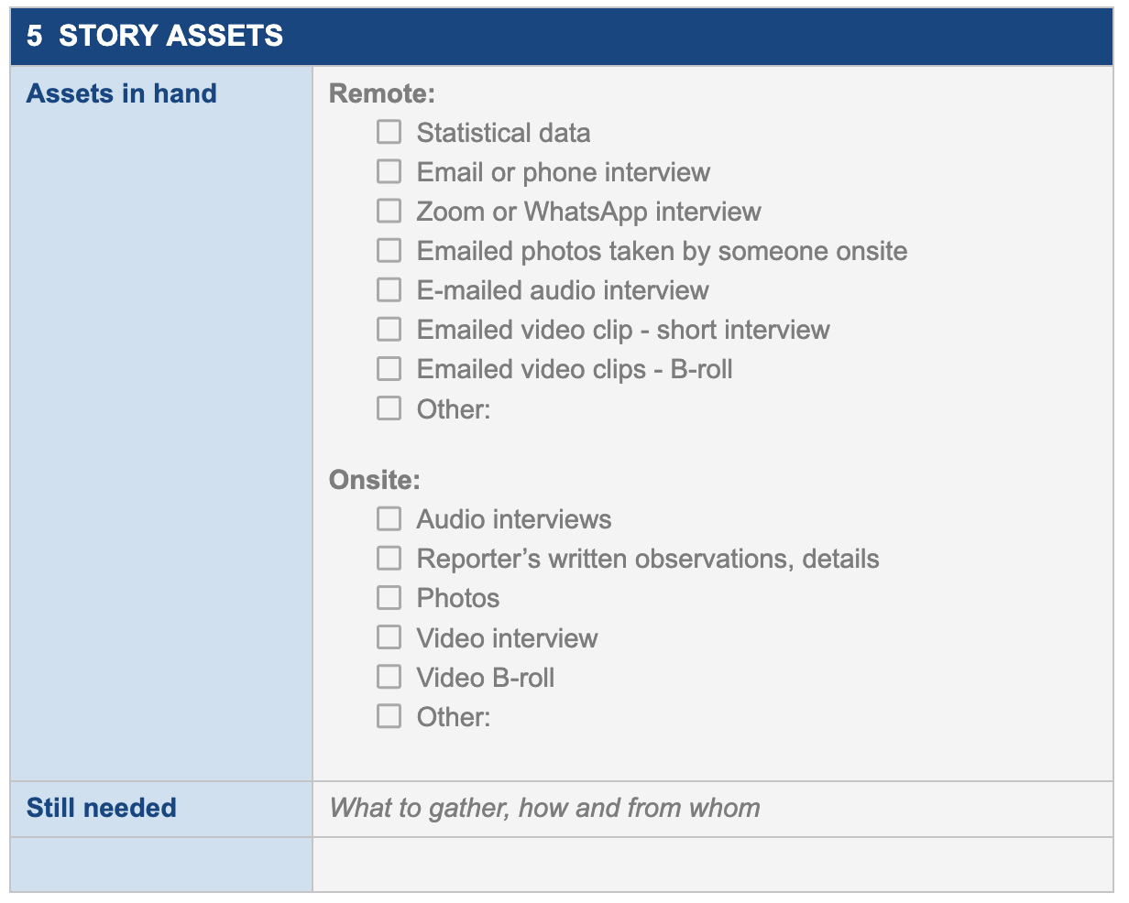

Slide 15
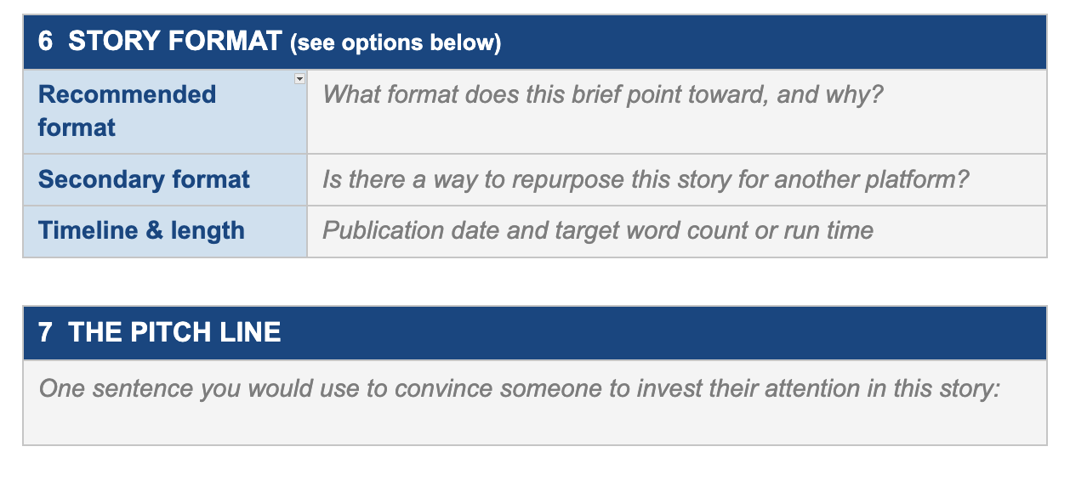

Slide 16
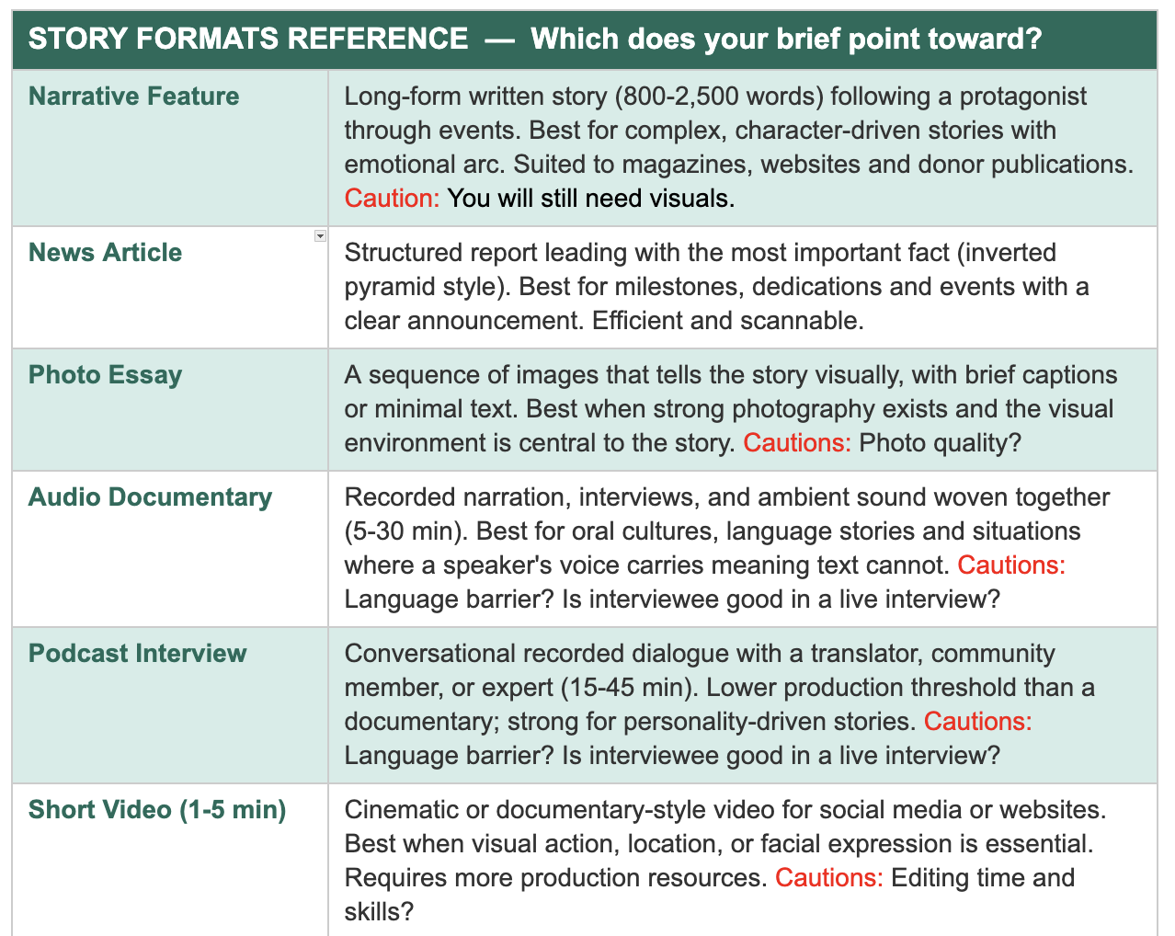

Slide 17
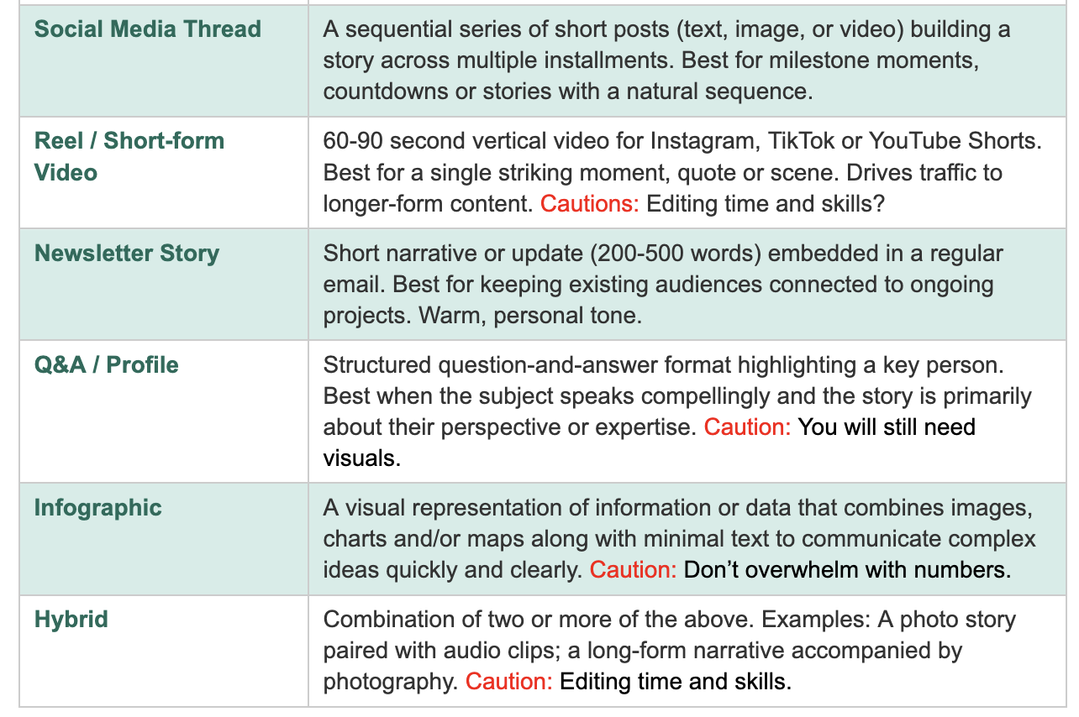

Slide 18

Still unsure? Ask 3 questions
What's the strongest part of my material — a face, a voice or a fact?
1
Where will my audience actually see or hear this?
2
What can I realistically produce with excellence by the deadline?
3
The best format is the one you can execute with excellence — not necessarily the most impressive one.

Slide 19
Quick Review: Key Takeaways
PLAN with your purpose in mind
before you gather a single quote or photo / consider audience
GATHER more than you think you need
whether you're on-site or remote / and don’t be overwhelmed
ORGANIZE around a story spine
not just the order things happened. 5 boxes or what happened? / why does it matter?
CHOOSE format by audience and resources
Use the Story Brief
Notes:
– but then be willing to change your mind if your reporting unearths something better

Slide 20
Questions / Discussion
Slides, a video and the adaptable Story Brief form will be shared soon
on the Communication Resources page at wycliffe.net.

